Slide 1
Load-shedding System for Escom customers
Project analysis
By
Andrew Mfune

Slide 2
Problem Areas
Difficult/inconvenient to keep track of load shedding schedule for a particular location on a regular basis.
Most customers might not be aware that a new schedule is out
It’s time consuming and difficult to pinpoint your current area in the load shedding program as all regions and areas in Malawi are put together in one large document.
The schedule is not reader friendly. Readers are required to identify the group their area is assigned and then locate the group on a table chart

Slide 3
Solution / System requirements
Application must maintain an up to date load shedding schedule
Provide remainders to users of upcoming blackouts in their area
Users must be able to track load shedding schedules for their places of interest
Provide notifications for new load shedding schedule
Provide a search interface to quickly locate locations affected by load shedding schedule

Slide 4
Project scope
Mobile platform for Domestic Escom customers
Will consume load shedding schedule
Web platform for Administration
Will serve load shedding schedules to mobile users

Slide 5
Actors
Escom
Releases load shedding schedule to the general public
Platform administrator
Retrieve load shedding schedule (from Escom’s publications)
Upload schedule to the system’s central database
Escom customers
Download schedule
View schedules by:
Searched areas
Tracked locations
Current area
Primary area of residence
All locations

Slide 6
General use case

Slide 7
General architecture
System domain
Public domain
Local database
1. Publish schedule
Newspaper
Escom
7. Update
Push service
Web Platform
3. Upload schedule
2. Monitor and retrieve schedule
@ Email
6. Push
5. Upload
Client
intermediary
Web
4. Format data

Slide 8
…continued
Escom publishes load shedding schedule
An intermediary, whether a separate system or a human monitors the public domain for load shedding schedule.
The intermediary uploads schedule to the web portal. This data might be entered manually into a form or parsed from an electronic document
The data is then formatted to the required standard of the push notification service.
The data is uploaded to the push service for storage and distribution
Push service updates the mobile client which is connected to the internet
The client updates it’s local database with the new schedule accordingly

Slide 9
About Escom’s load-shedding schedule
Customers are grouped into two
Domestic
Industrial
Schedules are grouped into the following regions:
Northern region
Southern region
Central region
Load shedding scenarios
Low power output (little water to generate enough power)
Equipment maintenance
For domestic customers, areas affected are grouped into letters.
Group letters are region contextual and are interchangable
Blackout starting time rotates between groups daily. i.e. If Group A gets a blackout on Monday in the morning, on Tuesday , group A will experience a blackout in the evening and another group will have a blackout in the morning.
Load shedding schedules can either be indefinite or definite

Slide 10
…continued
Load shedding schedules are distributed in the following formats:
HTML (Web)
Print media
Customers can subscribe to escom’s mailing list to get up to date information about schedules…

Slide 11
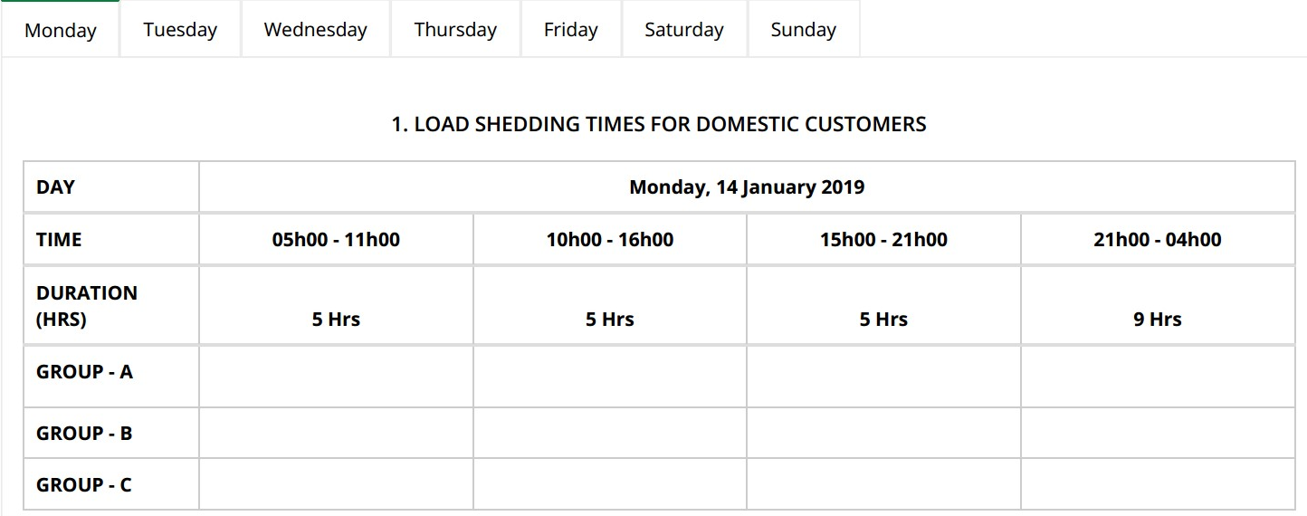
The schedule

Slide 12
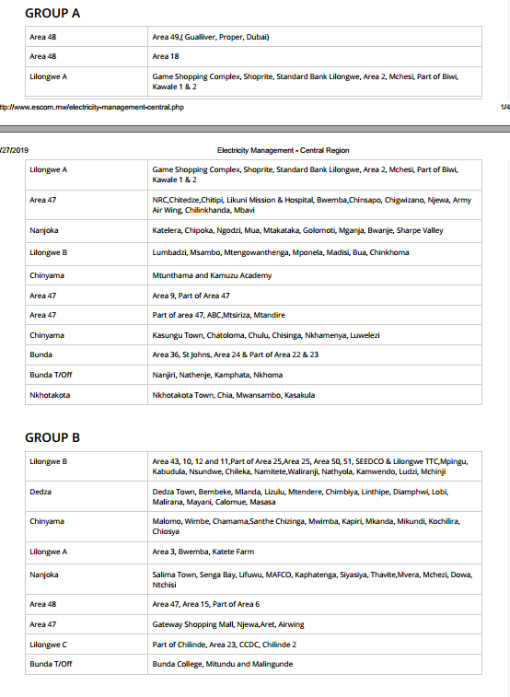
Domestic customer groupings

Slide 13
Data
Schedule
ID | Date | Starting Time | Finish time | Duration | Group ID
Group
Monitored locations
ID | Group name | Area ID
ID | Area ID | Is Primary
Location
Region
ID | Location name
ID | Region name

Slide 14
Class diagram

Slide 15
Project schedule
Week 1
Analysis and design
Database classes implementation
Database Queries implementation
Database unit tests
UI implementations

